Slide 1
WEB Scrapping project
Camille Libert-Coubard
April 2020

Slide 2
Table of contents
Objective
Web scrapping methodology
Results
Conclusion

Slide 3
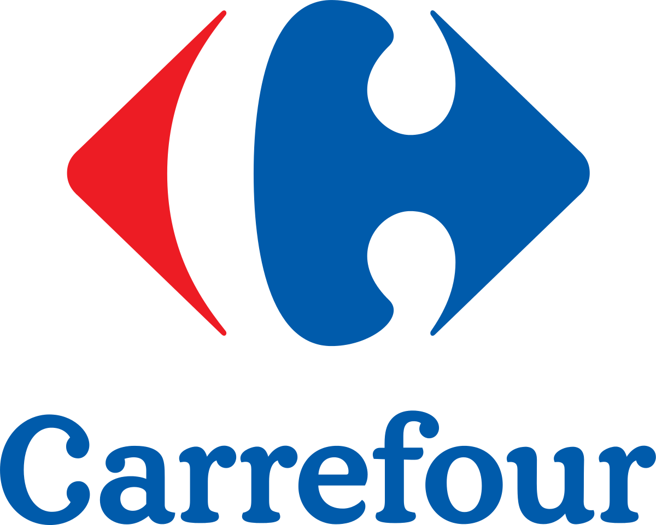
Objective
Collect information about products being promoted on Carrefour.com
Understand the promotions, and more specifically:
The number of promotions
The categories and subcatgories being the most promoted
The type of promotion
The brands promoting the most on the website
Project aimed at:
Carrefour competitors
Industrial brands

Slide 4
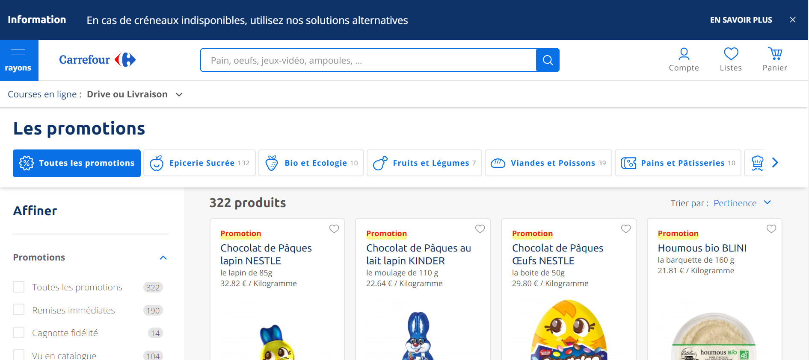
Carrefour webpage
https://www.carrefour.fr/promotions

Slide 5
Web Scrapping methodology
Establish scrapping method
Choosing API as it gives more information
Compute number of pages to be scrapped
Using Beautiful Soup to retrieve the number of articles
Scrap all promotion pages
Output: raw dataframe with all the information on promotions
Cleaning the data obtained
Output: a clean dataframe and a few graphs describing the data

Slide 6
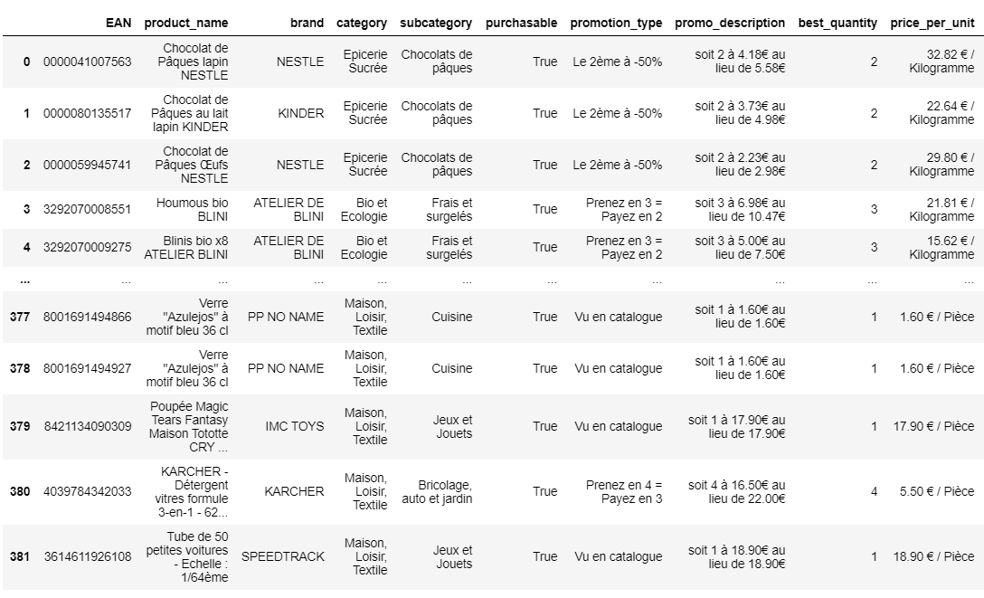
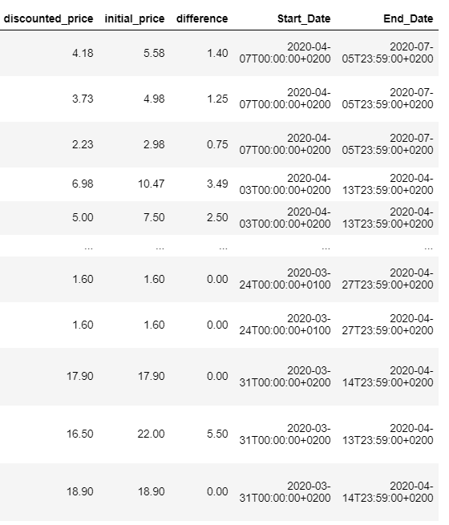
results

Slide 7
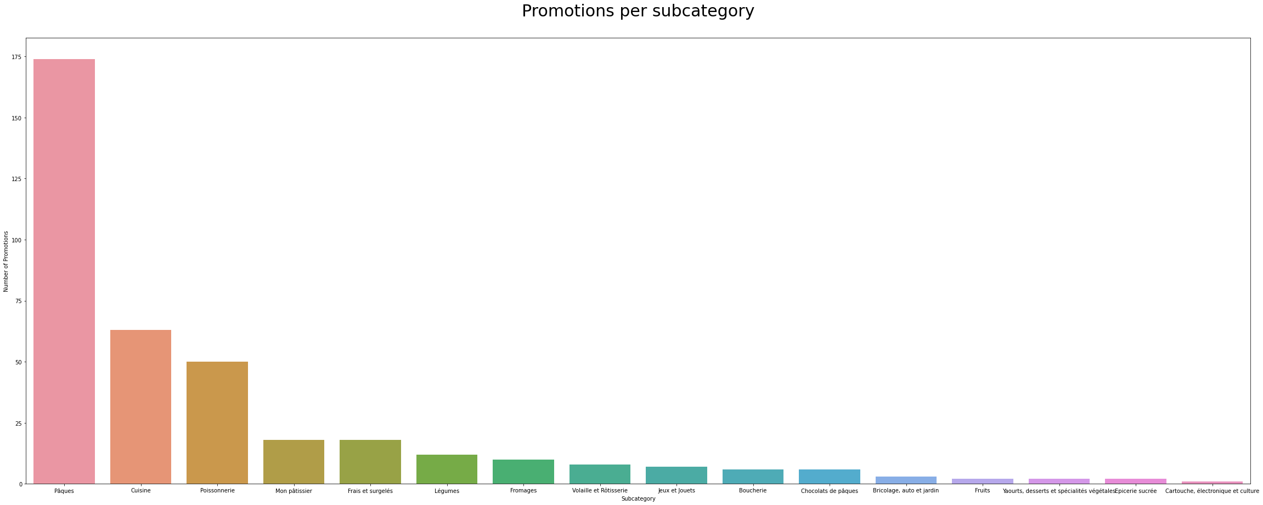
results

Slide 8
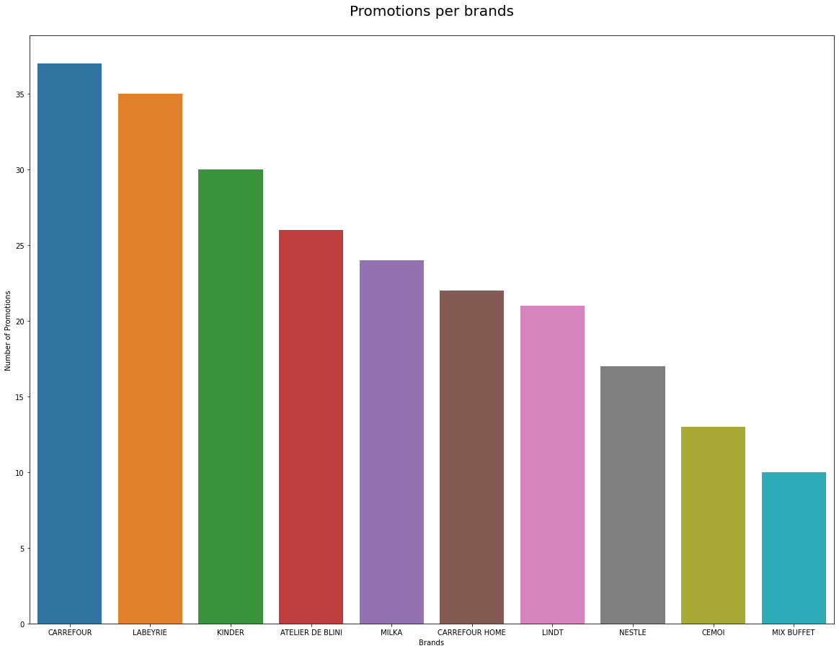
results

Slide 9
Conclusion
Obstacles
Choosing the right website and scrapping method
Learnings
How a website is structured
How to clean a json output
Better understand functions and data pipelines
Improvements
Scrapping competitors websites

